Slide 1
Bus Reservation system
NAME: A.DIVYA
COLLEGE ID:(AMSEC)_6202
Reg No:620221104005

Slide 2











BUS RESERVATION
BUS RESERVATION SYSTEM IS A TOOL THAT ALLOWS USERS TO BOOK TICKETS FOR THEIR JOURNEY IN ADVANCE. IT OFFERS MULTIPLE FEATURES TO PROVIDE A HASSLE-FREE EXPERIENCE TO A TRAVELER. THIS ARTICLE AIMS AT BUILDING A RUDIMENTARY BUS RESERVATION SYSTEM.

Slide 3
ABSTRACT :
Use the adjective abstract for something that is not a material object or is general and not based on specific examples.
Abstract is from a Latin word meaning “pulled away, detached,” and the basic idea is of something detached from physical, or concrete, reality. It is frequently used of ideas, meaning that they don’t have a clear applicability to real life, and of art, meaning that it doesn’t pictorially represent reality. It is also used as a noun, especially in the phrase “in the abstract” (a joke has a person laying down a new sidewalk saying “I like little boys in the abstract, but not in the concrete”), and as a verb (accented on the second syllable), meaning “to remove.”

Slide 4
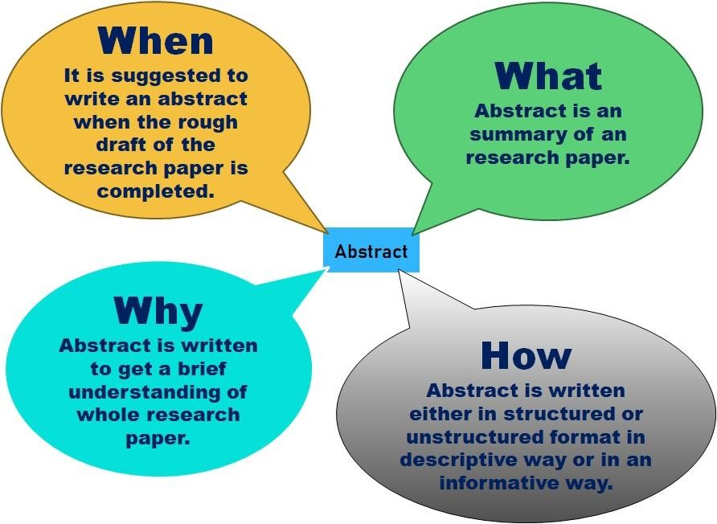

Slide 5
PROBLEM STATEMENT:
The problem statement is your opportunity to explain why you care and what you propose to do in the way of researching the problem. A problem statement is an explanation in research that describes the issue that is in need of study. What problem is the research attempting to address?

Slide 6
A problem statement is a description of an issue to be addressed or a condition to be improved upon. It identifies the gap between the current problem and goal. The problem statement should be designed to address the Five Ws. The first condition of solving a problem is understanding the problem, which can be done by way of a problem statement.[1]
•
Problem statements are used by most businesses and organizations to execute process improvement projects.[2]

Slide 7
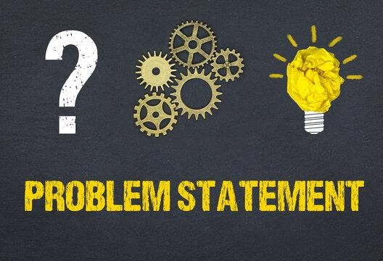

Slide 8
PROJECT OVERVIEW:
A project overview is a detailed description of a project’s goals and objectives, the steps to achieve these goals, and the expected outcomes. In addition, a project overview enables you to outline the project schedule, budget, necessary resources, and status.

Slide 9
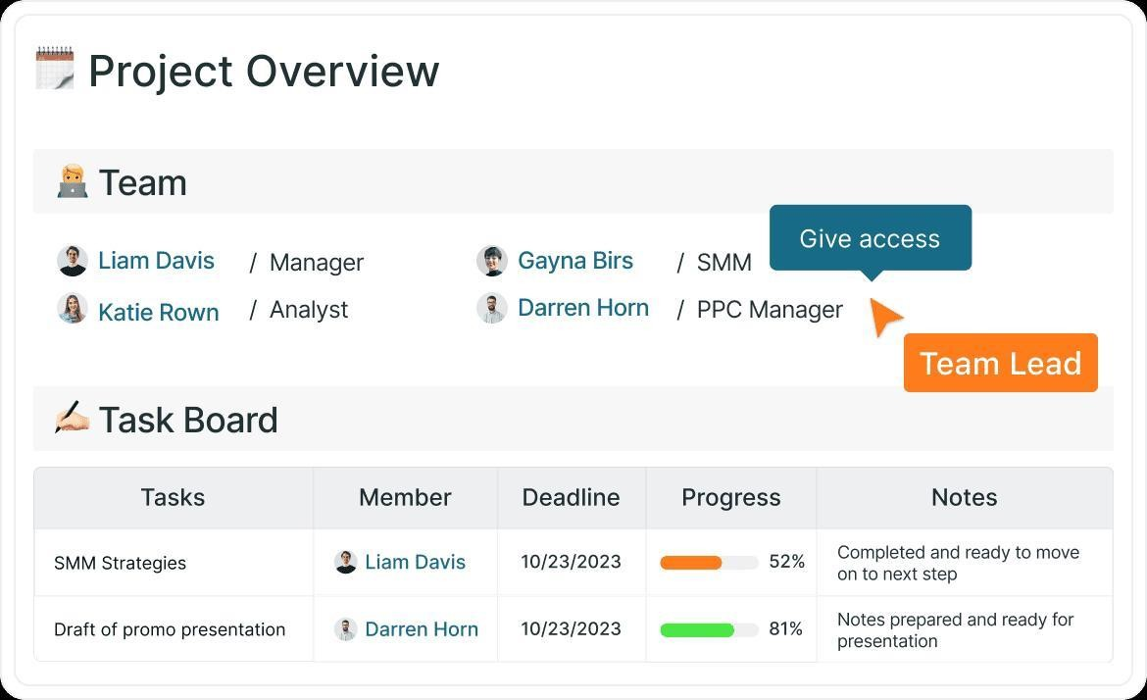

Slide 10
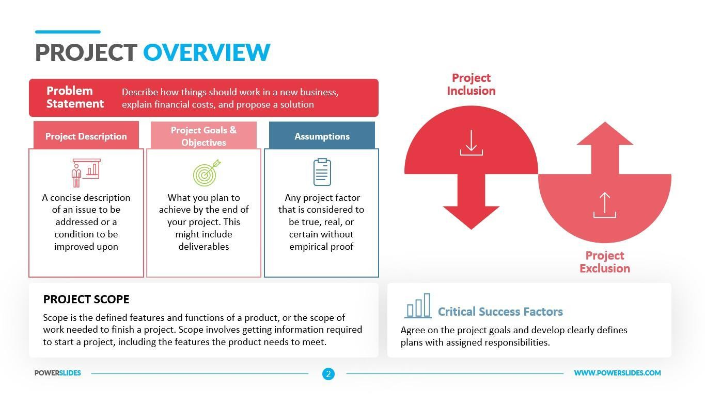
EXAMPLE:

Slide 11
TECNOLOGY VIEW:
Technology is the application of conceptual knowledge for achieving practical goals, especially in a reproducible way. The word technology can also mean the products resulting from such efforts, including both tangible tools such as utensils or machines, and intangible ones such as software..

Slide 12


Slide 13
The Technology viewpoint creates a view of all of the technology types used by the enterprise to deliver the products and services to customers. The resulting technology view contains 100% of the technology needed to support the enterprise.

Slide 14
MODELING & RESULTS:
When a predictive model completes, the results section allows you to switch between viewing Combined model results and Individual model results. The combined model results include distribution and variable importance charts for the combined model that was built, providing a quick visual assessment of model performance and of the importance of different predictors in obtaining the final result. The individual model results list information about all the individual models that make up the combined model, allowing you to click each individual model to view its details.

Slide 15
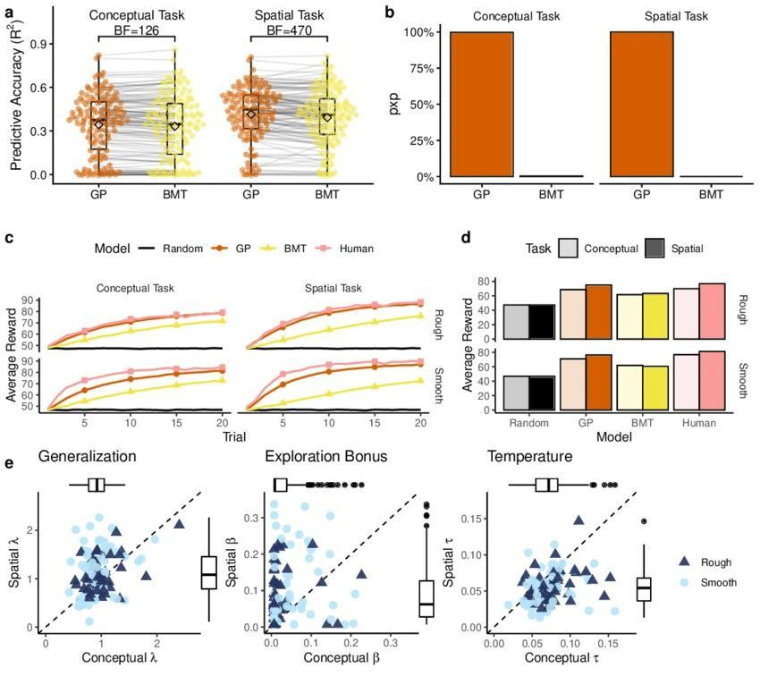
Calculating predictor importance may take significantly longer than model building, particularly when using large datasets.

Slide 16
SCREEN SHOT:
A screenshot, sometimes referred to as a screencap or screengrab, is an image that shows the contents of a computer screen. These captures let you capture exactly what you see on your screen and are often shared with others or used as a reference point later on. But what is a screenshot, and how do you take one?
•
Taking, saving, and sharing screenshots can be extremely helpful. Some insist that it is one of their most powerful tools. But how can a simple picture of your screen be so vital? Well, they often act as an artifact. They serve as a way to prove to others that you are seeing the crazy stuff you’re seeing.

Slide 17
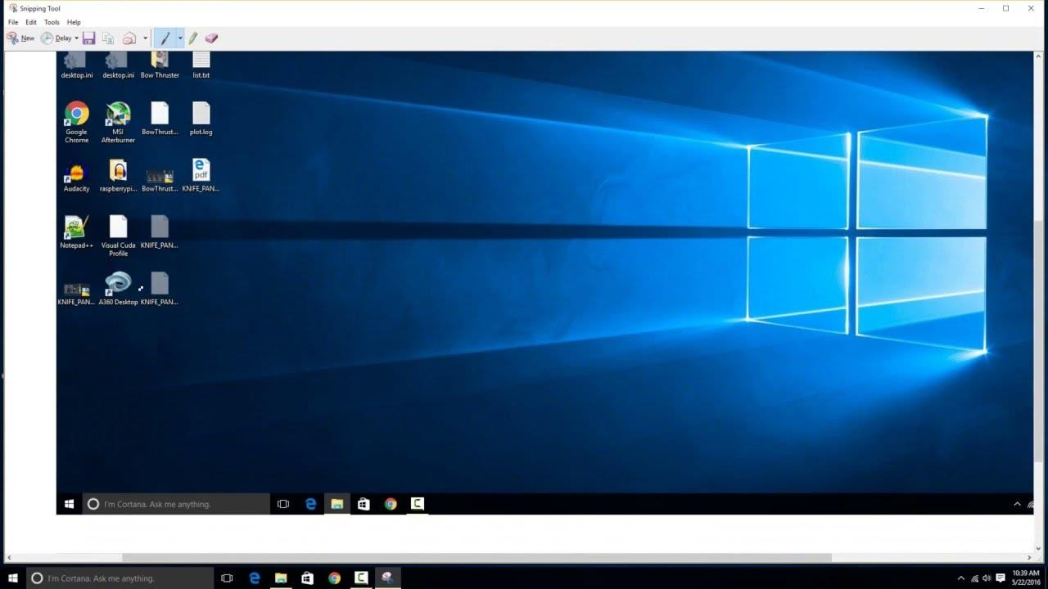

Slide 18
FUTURE ENHANCEMENT:
Future Enhancements means (i) any enhancements to the State’s RSS-II
System, (ii) any new features developed for the State’s RSS-II System, or
(iii) the integration of any other ES Customer Contract enhancements into
the State’s RSS-II System.
Future scope refers to the potential opportunities and prospects in a
particular field, industry, or career. It’s essential to consider because it
helps individuals make informed decisions about their education, career,
and personal development.

Slide 19

As Telemedicine services are considered as the future of healthcare sector, India needs a legislation that is consolidated yet simple and robust, that not only address the current challenges but also have the scope for accommodating future changes and addressing future challenges.24 Nov 2023

Slide 20
CONCLUSION:
What Is a Conclusion? A conclusion is the final piece of writing in a research paper, essay, or article that summarizes the entire work. The conclusion paragraph should restate your thesis, summarize the key supporting ideas you discussed throughout the work, and offer your final impression on the central idea.

Slide 21

Here is an example of an effective conclusion paragraph:"Though there has been much debate on the subject, it is clear that democratic leadership is the best form of management for the modern workplace.

Slide 22


